Slide 1
SPLIT ARRAY WITH SAME AVERAGE
BY
S. Praveen Kumar (192210546)
Photo by Pexels

Slide 2
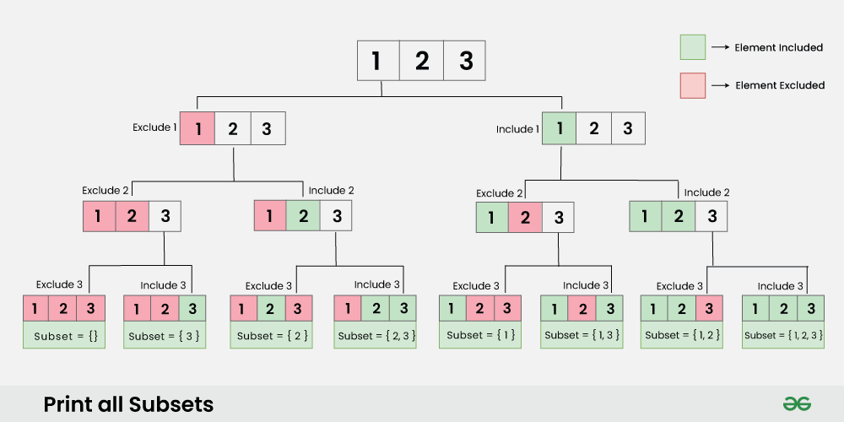
Introduction:
Two arrays, A and B, must maintain the same average if split correctly, ensuring a thorough exploration of algorithms.
The goal is to determine the feasibility of such splits using an innovative approach in algorithm design and analysis.
Understanding this can pave the way for efficient solutions in various computing scenarios and real-world applications.
The Split Array with Same Average problem involves determining whether an array can be split into two non-empty subarrays such that the average of the elements in both subarrays is the same. This problem is computationally challenging because it requires checking various combinations of subsets.
A common approach to solving it involves using backtracking to explore possible partitions and dynamic programming (DP) to optimize the process by storing intermediate results, thus avoiding redundant calculations and improving efficiency. This hybrid approach helps reduce the complexity of finding a valid partition, making it feasible for larger arrays.
Photo by Pexels

Slide 3

2
The Problem Statement
Understanding the Challenge
Given an array of up to 30 positive integers, our goal is to split it into two arrays with equal averages. Constraints emphasize all values must be under 10,001, ensuring the problem remains manageable yet challenging. The solution requires exploration of all possible partitions to find if such a split exists—requiring robust algorithmic thinking. This presents a fascinating problem in the field of algorithms, encouraging innovative problem-solving strategies.
Photo by Pexels

Slide 4

3
Proposed Design Work
Innovative Approach
The design utilizes backtracking and dynamic programming to explore potential array splits efficiently. Backtracking allows exploration of all splits while maintaining conditions for equal averages in A and B arrays. Dynamic programming aids by storing intermediate results, enhancing performance and reducing redundant calculations. Incorporating memoization is key for optimizing recursive calls and improving the design's overall efficiency.
Photo by Pexels

Slide 5
Time complexity:
Best Case Time Complexity: O(n⋅S)O(n⋅S) This occurs when the solution is found early in the backtracking process, and we don't need to explore all possible subsets.
Worst Case Time Complexity: O(2n⋅n⋅S)O(2n⋅n⋅S) This happens when all subsets need to be explored, meaning the backtracking algorithm examines every possible subset.
Average Case Time Complexity: O(2n/2⋅n⋅S)O(2n/2⋅n⋅S) On average, we expect to explore half of the subsets before finding a valid solution or concluding that no solution exists.

Slide 6
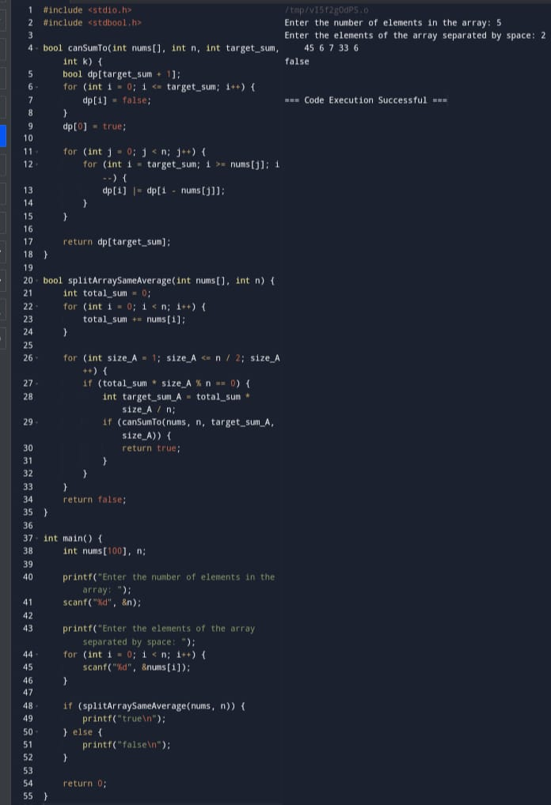
Program & Output:

Slide 7

4
Functionality Breakdown
How It Works
The code attempts to split the input array by exploring combinations using a recursive function. Key conditions check for valid splits that maintain equal averages in both resulting arrays A and B. Various internal calculations, like total sum and current selection status, guide the decision-making process. The return statement determines success or failure in achieving equal averages, completing the functionality cycle.
Photo by Pexels

Slide 8
Future Scope:
1. **Optimization for Large Datasets**: As arrays grow larger, even with dynamic programming, the time complexity may become prohibitive. Future work can focus on further optimizing the algorithm to handle large datasets efficiently, possibly by leveraging advanced pruning techniques, heuristic-based search, or parallel processing.
2. **Application to Real-World Problems**: The concept of partitioning arrays into subsets with the same average can be applied to various fields, such as load balancing, financial portfolio distribution, and resource allocation. Exploring specific adaptations of the algorithm for these domains could yield practical tools for optimization.
3. **Integration with Machine Learning**: Machine learning models could be trained to predict the feasibility of splitting an array into subsets with the same average. By analyzing patterns in the input data, these models could potentially guide the backtracking process to focus on more promising branches, reducing the search space.

Slide 9

5
Conclusion
This project showcases the power of algorithms in solving complex problems through systematic approaches. By applying advanced techniques like backtracking and memoization, we can tackle challenging computational tasks. Thank you for your attention; we hope this presentation inspires further exploration in algorithm design and analysis. Feel free to ask any questions or discuss insights regarding this capstone project or algorithms in general!
Photo by Pexels

Slide 10


